Slide 1
Digital Humanities
A Capstone Project by William “Greg” Dawkins, Marlene Williams, and Kevin Woods
Commissioned by Katia Mayfield
Presided over by Dr. Adam Lewis

Slide 2
What is the Digital Humanities Project?
Goals
Determining the sequential order of digital files.
Use Levenshtein’s Distance algorithm to determine the order.
Pick three different algorithms to compare to Levenstein’s Distance
Compare results
Compare time management
Write a publishable research paper on comparisons

Slide 3
How Were the Goals Accomplished?
Three Sprints
Sprint 1 – Research
Research Levenshtein’s Distance algorithm
Research three alternative algorithms for comparison
Code Levenshtein’s Distance algorithm
Sprint 2 – Coding
Each member codes the alternative algorithms picked
Tests were run to compare
Do comparisons
Each member ran the program on individual computers
Each member recorded results
Sprint 3 – Results and Writing
Results were compared using Microsoft Excel charts
Each member wrote about their individual algorithms
Rough Draft and final draft was submitted to Ms. Mayfield for approval

Slide 4
Jaro-Winkler Algorithm
Developed by
Matthew A. Jaro – System Automation Corp./MatchWare Technologies, Inc.
Bill Winkler – U.S. Bureau of the Census
Published in
Proceedings of the Section on Survey Research Methods (ASA) pp. 354-359
String Comparator Metrics and Enhanced Decision Rules in the Fellegi-Sunter Model of Record Linkage
1990

Slide 5



How Jaro-Winkler works
Jaro-Winkler requires two parts
Obtain the Jaro score of two strings being compared
Where matches (m) are within the range shown below and transpositions (t) are counted
Obtain Jaro-Winkler score by determining if arbitrary boost threshold is met and apply boost prefix if so:
Where l is the length of the common prefix of the strings and p is a constant scaling factor
Some implementations do not make use of the boost threshold and would always fall in the otherwise formula

Slide 6
Levenshtein’s vs. Jaro-Winkler
Using Emily Dickinson Poem
Using Kevin’s input

Slide 7
Time Complexity for Jaro-Winkler
Using the Emily Dickinson Poem

Slide 8
Hunt-McIlroy Algorithm
Developed by
J. W. Hunt – Department of Electrical Engineering at Stanford University
M. D. McIlroy – Bell Laboratories
Published in
Bell Laboratories Computing Science Technical Report #41
An Algorithm for Differential File Comparison
1976

Slide 9
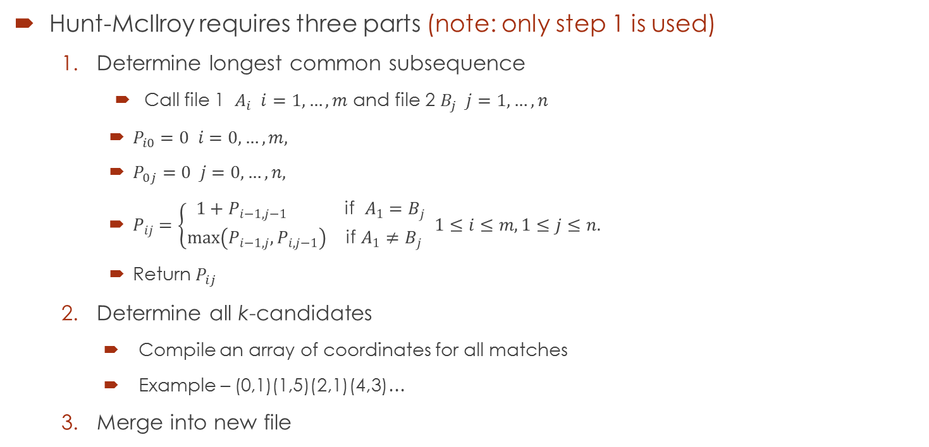
How Hunt-McIlroy works
Hunt-McIlroy requires three parts (note: only step 1 is used)
Determine longest common subsequence
Call file 1 $A_{i} i=1,…,m$ and file 2 $B_{j} j=1,…,n$
$P_{i0}=0 i=0, …, m,$
$P_{0j}=0 j=0,…,n,$
$P_{ij}=\left\{\begin{aligned}1+P_{i−1,j−1} \text{if} A_{1}=B_{j} \\ \max\left(P_{i−1,j},P_{i,j−1}\right) \text{if} A_{1}≠B_{j} \end{aligned}1≤i≤m, 1≤j≤n.\right.$
Return $P_{ij}$
Determine all k-candidates
Compile an array of coordinates for all matches
Example – (0,1)(1,5)(2,1)(4,3)…
Merge into new file

Slide 10
Levenshtein’s vs Hunt-McIlroy
Using Emily Dickinson Poem
Using Marlene’s Input

Slide 11
Time Complexity for Hunt-McIlroy
Using the Emily Dickinson Poem

Slide 12
Needleman-Wunsch Algorithm
Developed by
Matthew A. Jaro – System Automation Corp./MatchWare Technologies, Inc.
Bill Winkler – U.S. Bureau of the Census
Published in
Proceedings of the Section on Survey Research Methods (ASA) pp. 354-359
String Comparator Metrics and Enhanced Decision Rules in the Fellegi-Sunter Model of Record Linkage
1990

Slide 13
How Needleman-Wunsch works
Jaro-Winkler requires two parts
Obtain the Jaro score of two strings being compared
Where matches (m) are within the range shown below and transpositions (t) are counted
Obtain Jaro-Winkler score by determining if arbitrary boost threshold is met and apply boost prefix if so:
Where l is the length of the common prefix of the strings and p is a constant scaling factor
Some implementations do not make use of the boost threshold and would always fall in the otherwise formula

Slide 14
Needleman-Wunsch Algorithm
Using Emily Dickinson Poem
Using Gregs Input

Slide 15
Time Complexity for Needleman-Wunsch
Using the Emily Dickinson Poem

